Slide 1
Software System Modeling

Slide 2

Agenda
Class diagrams
Package diagrams
Component diagrams

Slide 3
Tools
https://www.lucidchart.com/ - component, package diagrams
https://mermaid-js.github.io/ - class diagrams

Slide 4
Parking lot exercise

Slide 5
Airport parking lot:
Contains multiple levels – 3 levels.
There are sensors at each parking slot that can identify if a slot is free or not
It has one entrance and one exit
At entrance there is a display with total free spots and per level
At the exit there is a camera that reads license plate and opens the barrier if ticket was paid
There are multiple payment kiosk on each level
The payment can be done both with cash and credit card

Slide 6
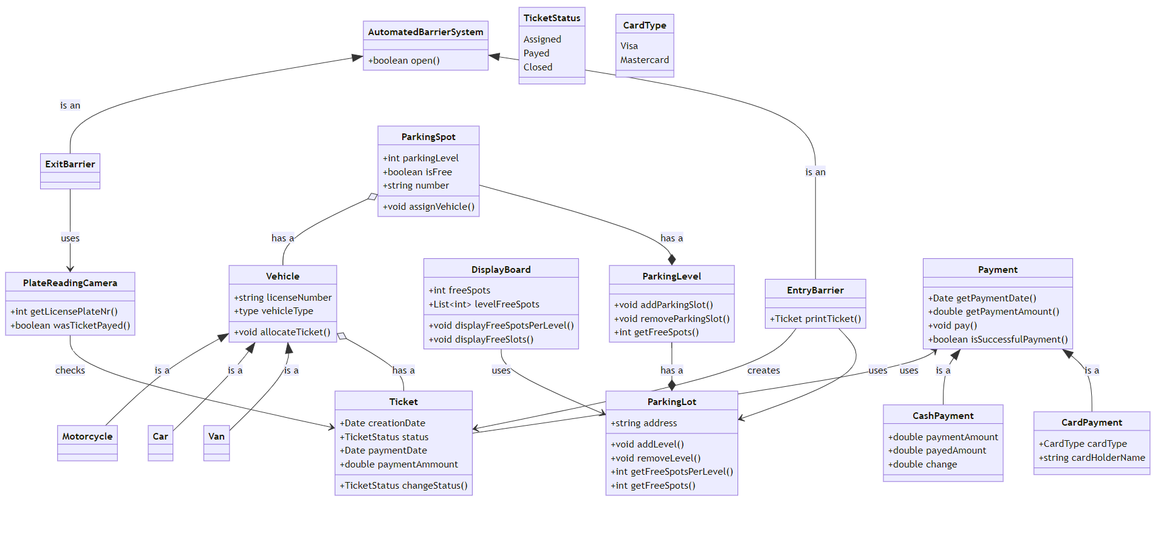

Slide 7
Package Diagram

Slide 8
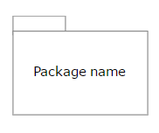

Package diagram is used to simplify complex class diagrams, you can group classes into packages. A package is a collection of logically related UML elements.
Package diagrams are most comonly used to provide a visual organization of the layered architecture within any UML classifier, such as a software system.
 | Package | Groups common elements based on data, behavior, or user interaction
 | Dependency | Depicts the relationship between one element (package, named element, etc) and another

Slide 9
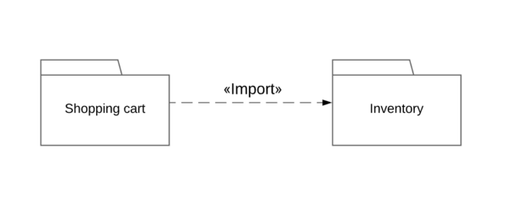
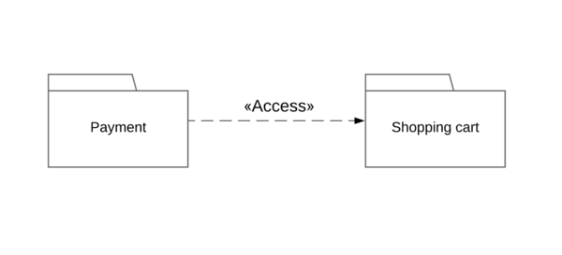
There are two main types of dependencies:
 | import | Indicates that functionality has been imported from one package to another.
 | access | Indicates that one package requires assistance from the functions of another package.

Slide 10
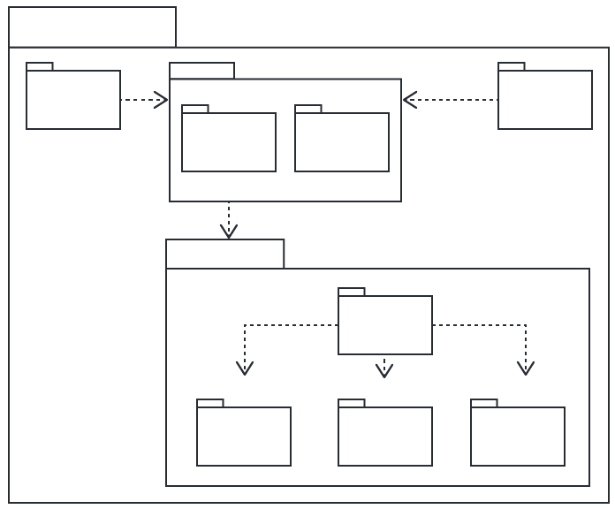

Slide 11
Exercise. Create package diagram based on class diagram for parking lot

Slide 12
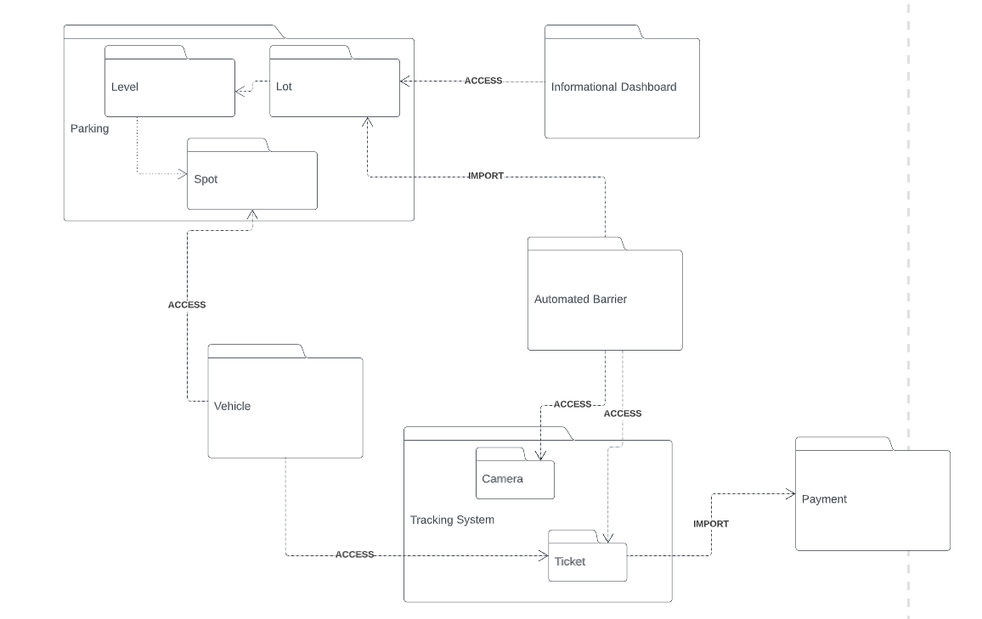

Slide 13
Component Diagram

Slide 14
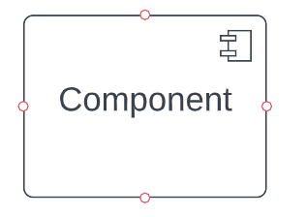

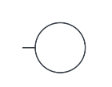
Component diagrams are essentially class diagrams that focus on a system's components that often used to model the static implementation view of a system.
 | Component | Modular part of a system that encapsulates its contents and whose manifestation is replaceable within its environment
 | Required interface | Represents the services the component needed in order to carry out its duty.
 | Provided interface | Represents the services to deliver by the exhibiting component

Slide 15
Exercise. Create Component diagram based on class diagram for parking lot

Slide 16
